Slide 1
Best Practices in Collaborating with Industry Professionals: “You can’t be all things to all people.”
Hannah Lee, Success Team Manager, Bottom Line
Julia Logan, Alumni Coordinator, Genesys Works
Melinda McIntire, Director of Alumni Services, Genesys Works

Slide 2
Agenda
Why you can’t be all things to all people
Introductions
Best Practices
Putting it to practice: Developing Your Own “Ask”
Share Out
Recommendations
Notes:
Julia
Introductions: Ourselves, why we are presenting, take a poll of the room
Best practices: These are themes and examples we have experienced: know there is a lot of knowledge in the room so we want to build off of it
Putting it to practice: Developing your own “ask”: the opportunity to think through your own strategies of working with a variety of stakeholders
Share out: opportunity to share best practices as a group
Recommendations: our overarching themes and wrap up

Slide 3
Outcomes
Attendees will leave with best practices to share with their own organization
Utilize industry partners
Utilize partnerships with other CBOs
Utilize relationships with educational institutions
Attendees will have the opportunity to develop their own ask for a stakeholder
Opportunity to hear from others about their best practices
Notes:
Hannah

Slide 4
Who we are
Notes:
Everyone

Slide 5
Why you can’t be all things to all people (and that’s ok!)
Funding
Capacity
Community Building
Trust the experts
Gaps in knowledge
Partnerships strengthen your organization
Notes:
Melinda
-capacity
-gaps in knowledge
-trust the experts
-funding
-partnerships make your organization stronger
-Community building

Slide 6
CBO to CBO
Create a pipeline
Sharing
Resources
Data (i.e. student progress)
Ideas
Know what others are doing so you don’t recreate the wheel and can use others’ resources
Be adaptable to year-to-year changes
Partnership agreement
Building relationships outside of office hours
Notes:
Valuable for CBOs to know what their strengths are, be mission specific, the ability to say no to things, know where to send the students you serve
Hannah: 1-4
Melinda: 5-6

Slide 7
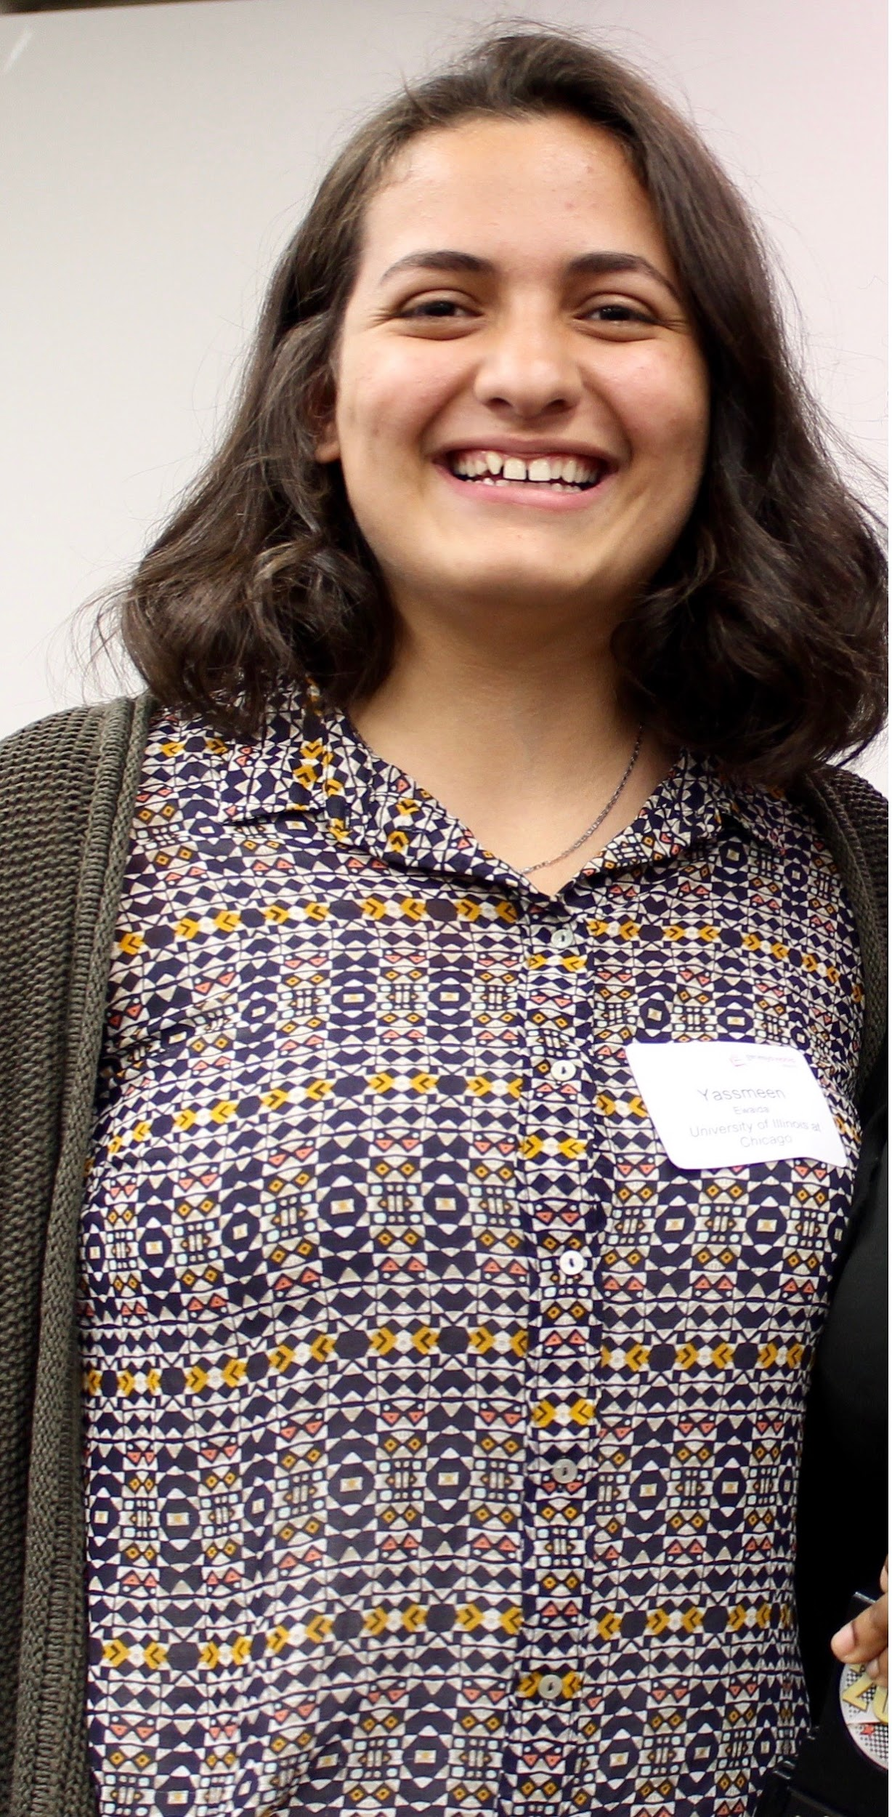
Student profile: Yassmeen
CBOs:
Genesys Works
Bottom Line
America Needs You (ANY)
Notes:
Hannah

Slide 8
CBO to Educational Institutions
Higher Education
High Schools
How are institutions serving our students?
Build your relationships strategically
Engaging at every level:
President for higher level
Other key players for implementation
School champions
Look for one in every office
Cost sharing
Mindful of trends: budget
Bringing three potential ways you can engage for the first meeting
Data and information sharing
School champions
Employment
Engage at every level
Go to them!
Notes:
Be aware of relationships that education institutions have with each other
Thank partners
Melinda: secondary education
Julia: H.E. 1
Hannah H.E. 2-6

Slide 9
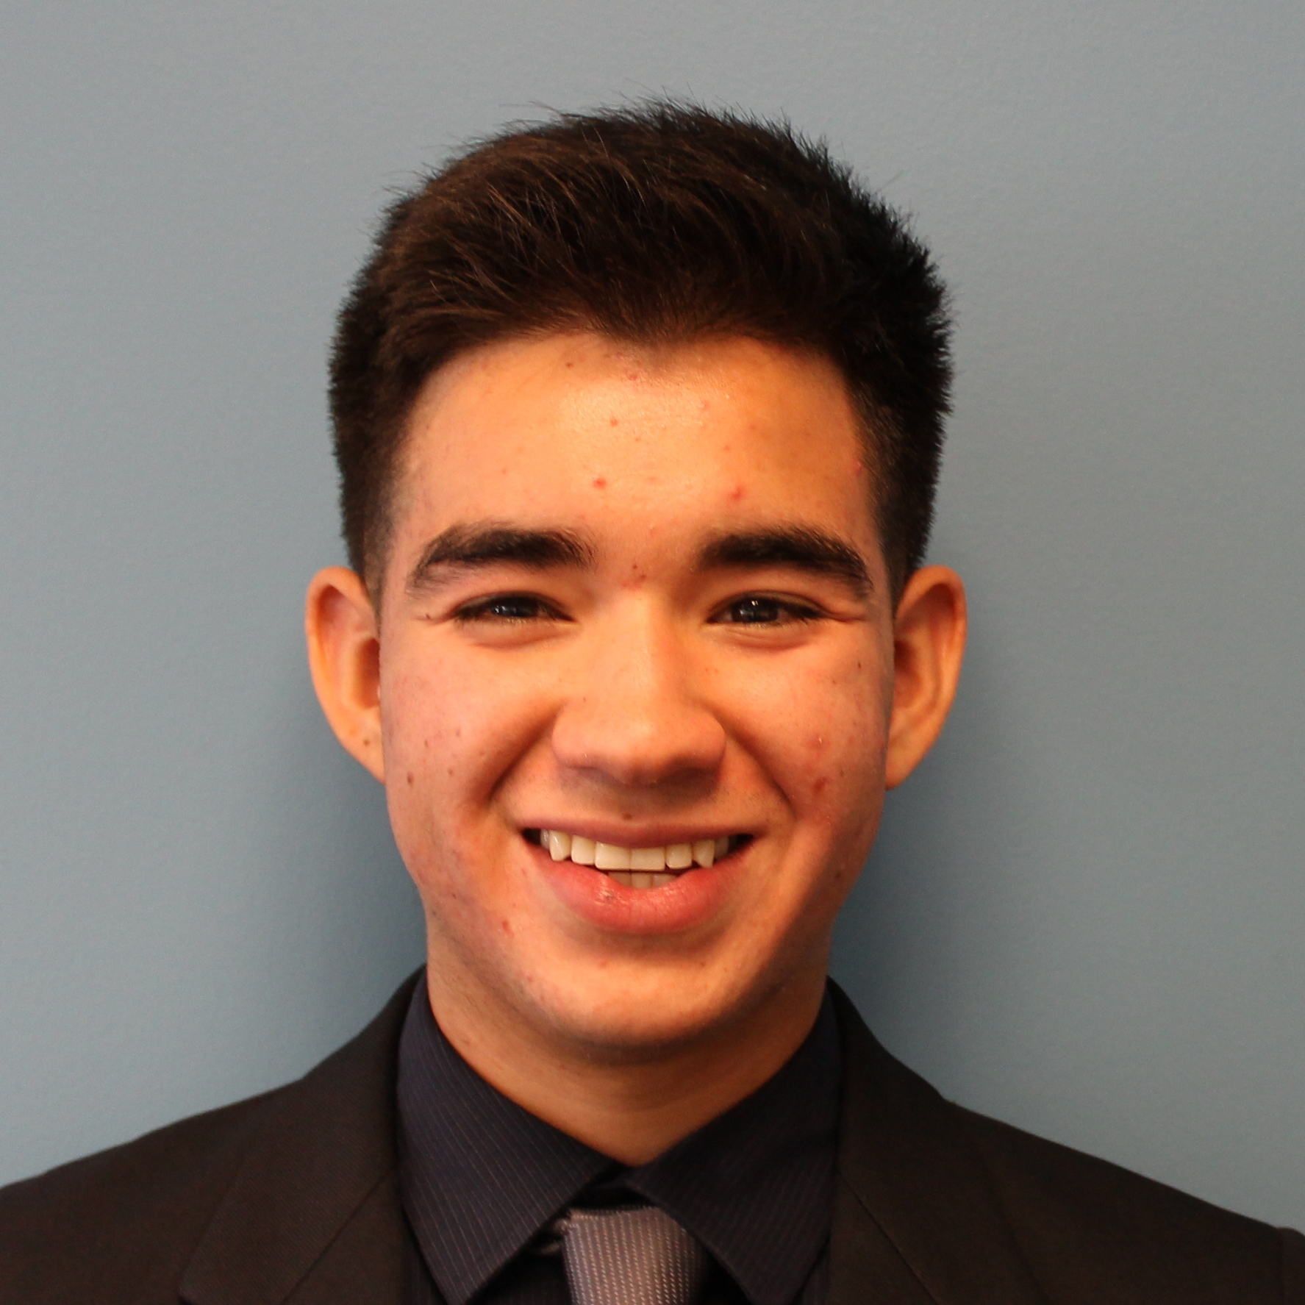
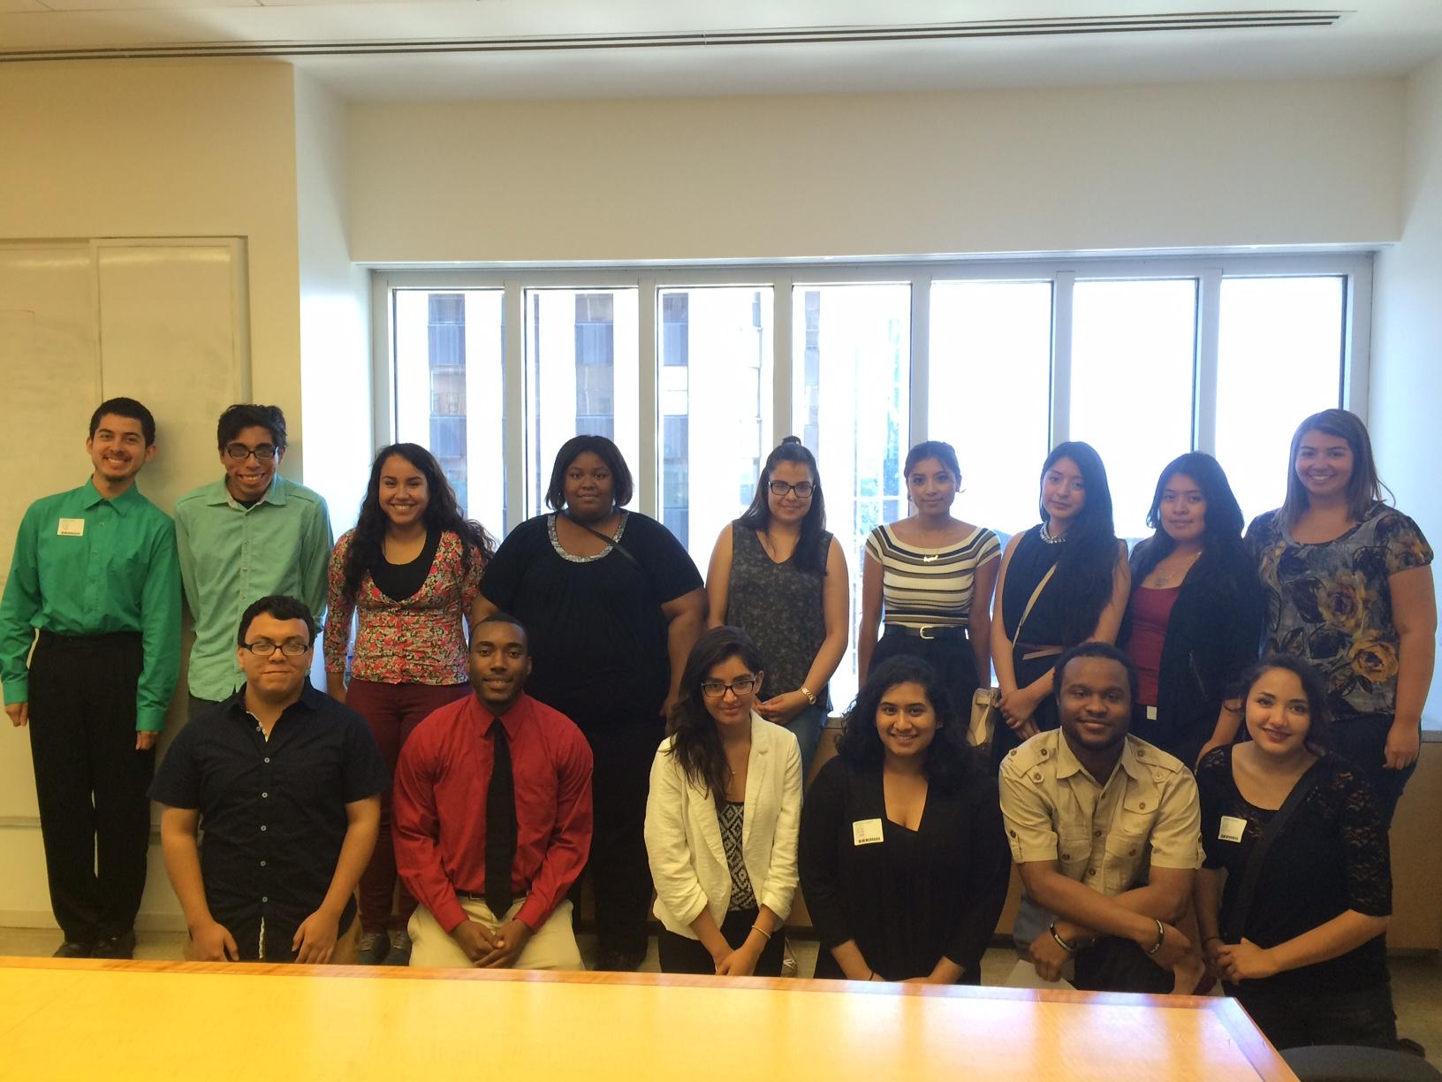
Student Profile
High Schools: Nic
Higher Ed: Angel
Notes:
Hannah: H.E.
Julia & Melinda: high schools

Slide 10
CBO to Employer Partners
Networking on behalf of your students
Knowing your data
Student profile
A seat at the table: know what’s happening in city
Start with a strategy
Small ask
Lay out options
Distinguishing between development opportunities and student opportunities
Matching students to employers
Internship survey
Employee profile
Notes:
Julia: 1-3
Hannah: 4-5
Julia: 6

Slide 11
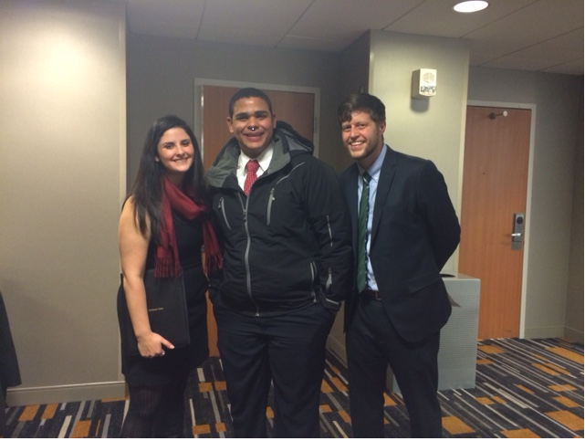
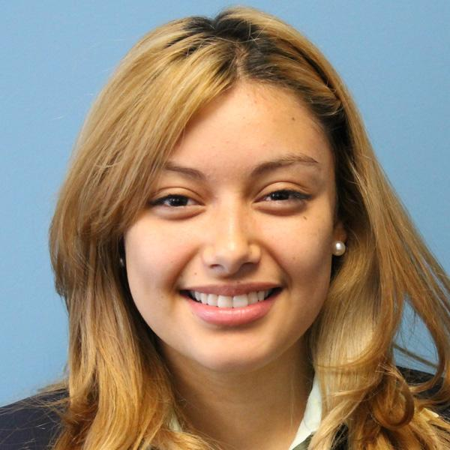
Student Profiles: Franny and Jessica

Slide 12
Themes
Have a specific ask!
Goals
Agenda
Recognize your strengths
Prioritize your resources
Put the student first
Respond to student needs
Notes:
Melinda

Slide 13
Collaborate and Share
Develop a specific ask and share with your table how you would approach that specific stakeholder
What is one of the ways in which you work with:
CBOs
Educational institutions
Industry
For industry and educational partners: how you can work with CBOs
Higher education:
Insider knowledge
Industry:
Financial Services Pipeline Initiative
Notes:
Hannah
**PRINT SHEETS**

Slide 14
Recommendations
CBOs
Employer Partners
Educational Institutions
Start small
Be mission specific
Be at the table
Thrive, The Forefront (CCAPs), To & Through Project
Remember common goals
Examine hiring pipelines
Match student profile to opportunities
Share hiring timelines and opportunities
Share data and institutional practices
Connect to people across campus
Notes:
M: CBO
H: Ed
J: Employers

Slide 15
Thank you! Questions? Contact us:
Hannah Lee
Success Team Manager
Bottom Line Chicago
T: 312.219.6254
C: 617.942.1020
hlee@bottomline.org
bottomline.org
Julia Logan
Alumni Coordinator
Genesys Works
T: 312.525.9994
jlogan@genesysworks.org genesysworks.org
Melinda McIntire
Director, Alumni Services
Genesys Works
T: 312.525.9996
mmcintire@genesysworks.org
genesysworks.org

